Slide 1


React Js
Session - 2
Date : 14 May 2019
Presented by : Deepak Porwal
Sundaramoorthy

Slide 2
What we’ll cover together
Our mission is to be the leader in enabling the global publishing and educational institu
tions to deliver online and offline learning
React HOOKS
useState
userEffect
Example
Demo for creating build & deployment
Drupal7 and React example
Notes:
This is topic for optimization.
‹#›

Slide 3
React HOOKS
Hooks are a new addition in React 16.8. They let you use state and other React features without writing a class.
Hooks let you use more of React’s features without classes.
A Hook is a special function that lets you “hook into” React features.
Hooks solve a wide variety of problems:
It’s hard to reuse stateful logic between components
Complex components become hard to understand
Classes confuse both people and machines
Hooks FAQ: https://reactjs.org/docs/hooks-faq.html
Notes:
‹#›

Slide 4
React HOOKS
Built-in Hooks in React (https://reactjs.org/docs/hooks-reference.html)
Basic Hooks
useState
useEffect
useContext
Additional Hooks
useReducer
useCallback
useMemo
useRef
useImperativeHandle
useLayoutEffect
useDebugValue
Notes:
‹#›

Slide 5
React HOOKS
Rules of Hooks
Only Call Hooks at the Top Level
Don’t call Hooks inside loops, conditions, or nested functions.
Only Call Hooks from React Function component or from custom Hooks
Don’t call Hooks from regular JavaScript functions
We can use ESLing Plugin that enforces these two rules. npm install eslint-plugin-react-hooks --save-dev
// Your ESLint configuration
{
"plugins": [
"react-hooks"
],
"rules": {
"react-hooks/rules-of-hooks": "error", // Checks rules of Hooks
"react-hooks/exhaustive-deps": "warn" // Checks effect dependencies
} }
Notes:
‹#›

Slide 6
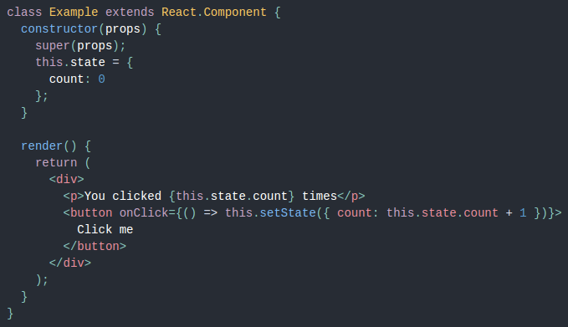
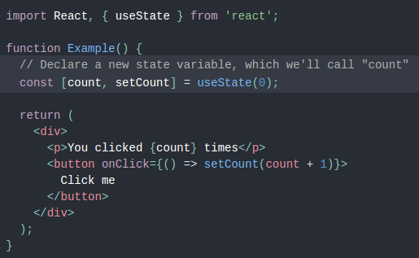
React HOOKS - useState
useState Example: router-hook/src/components/Hook.js
useState returns an array of:
state object (getter)
updater function (setter)
Notes:
‹#›

Slide 7
React HOOKS - useEffect
useEffect (Example: router-hook/src/components/Hook.js)
Using this Hook, you tell React that your component needs to do something after render.
It is similar to componentDidMount, componentDidUpdate, componentWillUnmount. Unlike componentDidMount or componentDidUpdate, effects scheduled with useEffect don’t block the browser from updating the screen.
If your effect returns a function, React will run it when it is time to clean up. (ie. similar to class life cycle componentWillUnmount)
Use Multiple Effects to Separate Concerns
Optimizing Performance by Skipping Effects
More detail find on : https://reactjs.org/docs/hooks-effect.html
Notes:
‹#›

Slide 8
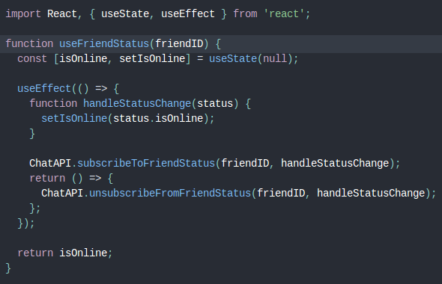
React HOOKS - custom hook
A custom Hook is a JavaScript function whose name starts with ”use” and that may call other Hooks.
Its name should always start with use so that you can tell at a glance that the Hook’s rules apply to it.
Notes:
‹#›

Slide 9
React build & deployment
Live Demo

Slide 10
React with Drupal 7
Live Demo

Slide 11
Q&A
Thank You

Slide 12
What next ?
React Advance Guide
Context
Refs and the DOM
Error Boundaries
Uncontrolled Components
Typechecking with props
JSX in depth
React bootstrap & Other Libraries
Redux Intro
Notes:
‹#›

